Slide 1


SAP UI5 & FIORI with OData TRAINING
Anubhav Oberoy & Shekhar Vedi
Day – 12

Slide 2

Agenda – Day 12
Method of Calling Funciton module
Basics of Connectivity
Steps to Setup the Cloud Connection.
Creating the destination in the BAS
Connecting with cloud connector in BTP
Integrating our Fiori App with the Odata service in BAS
Configuring ui5.yaml file to use oData service in VS Code
Implementing the Get Entity Set in UI
Getting the Association in UI

Slide 3

Basics of Connectivity and Role of SCC
Internet
Intranet
SAP BW
SAP ECC
SAP S/4 Hana
SAP BTP (PublicCloud)
SAP Cloud Connector
SAP On-premise System
SAP Business Application Studio
SCC
Destination
S/4 Hana Cloud
Field Glass
Sales Force

Slide 4
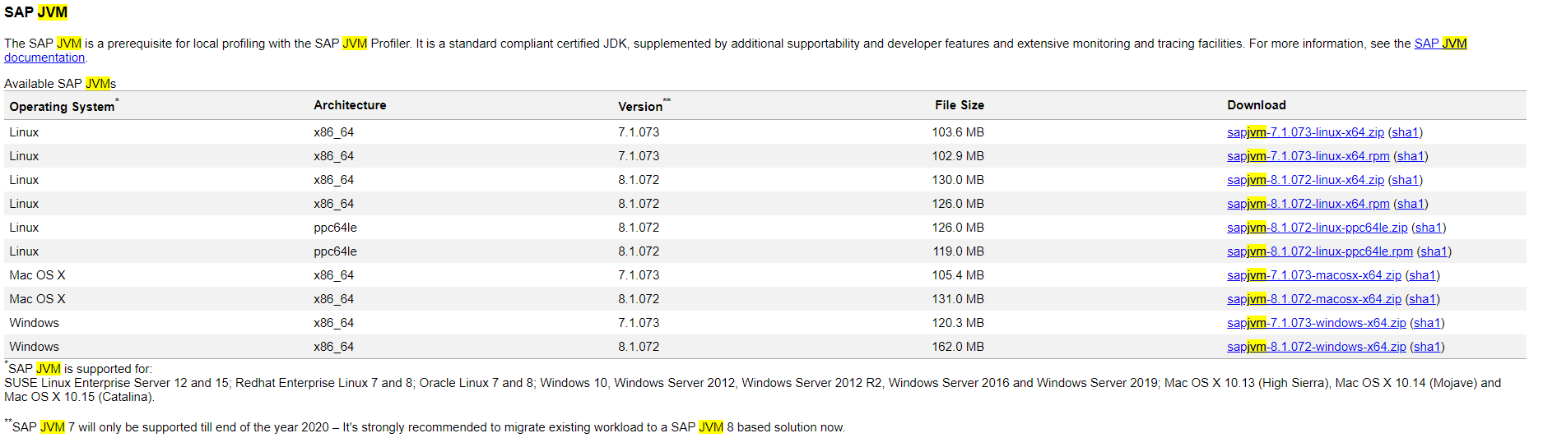
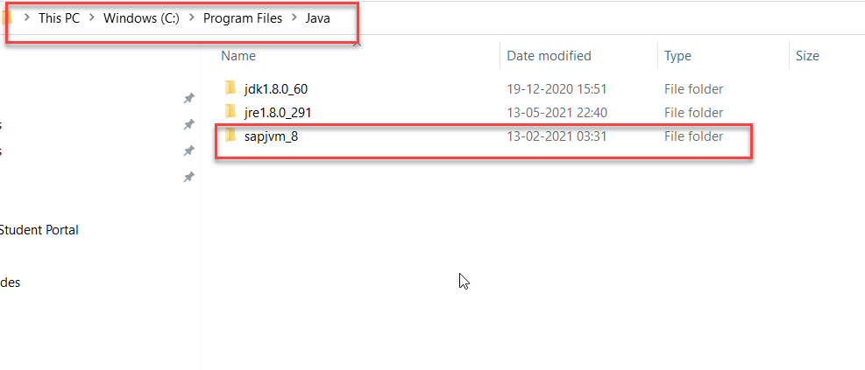
Cloud Connector
Step 1: Download SAP JVM and Extract it in the C:\Program Files\Java

Slide 5
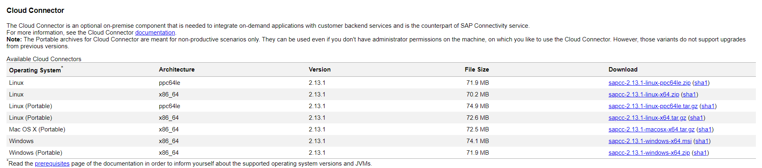
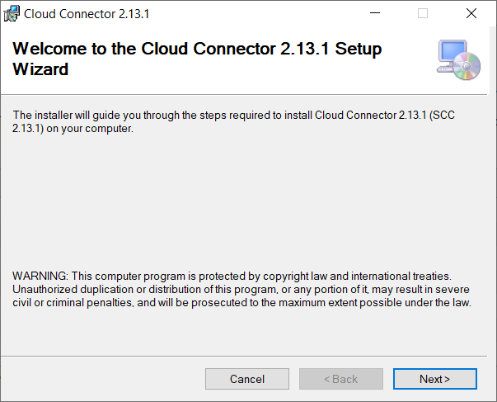
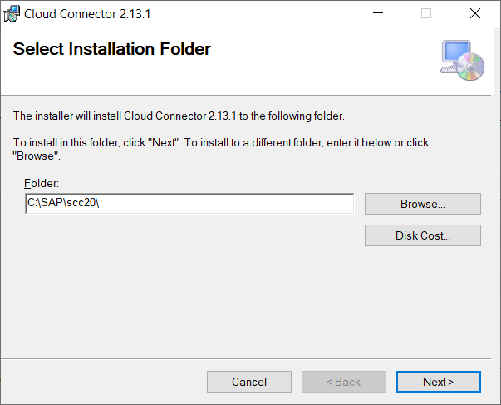
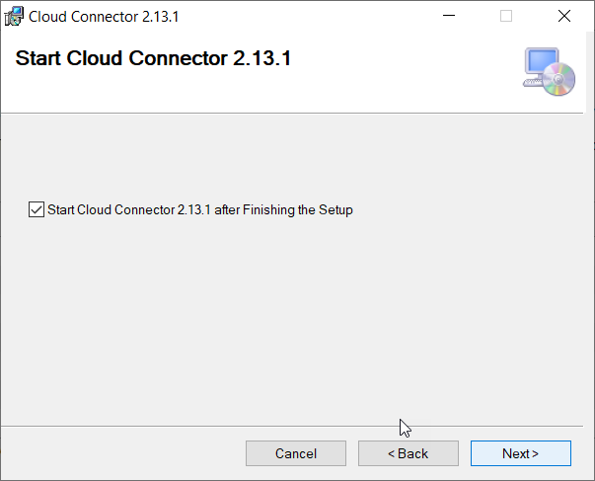
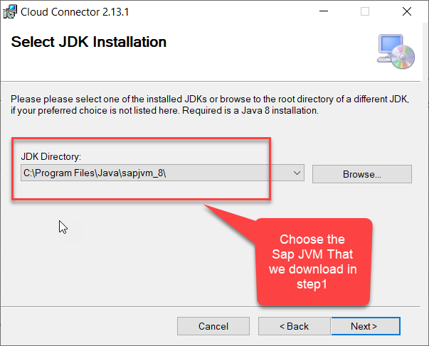
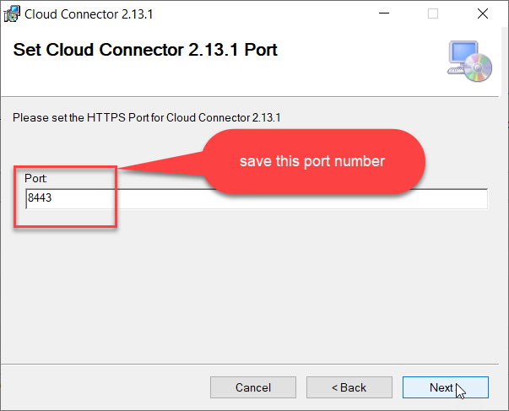
Cloud connector continue…
Step 2: Download and install the sap Cloud connector

Slide 6
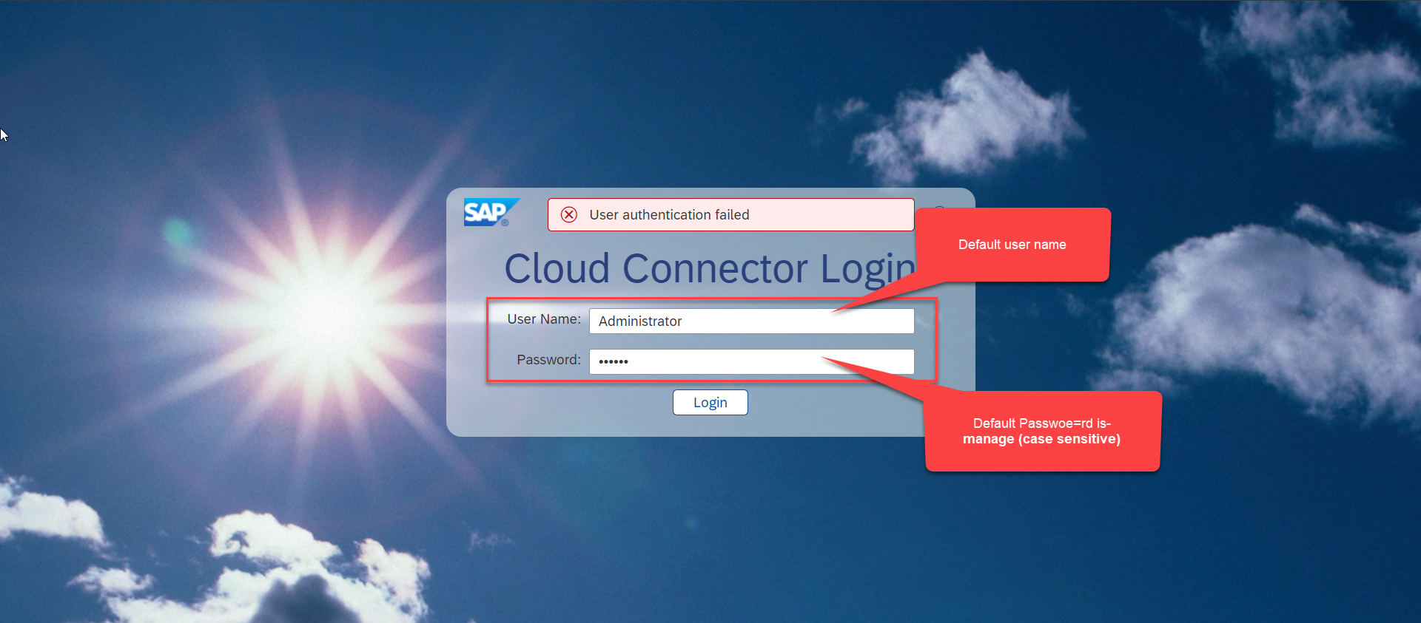
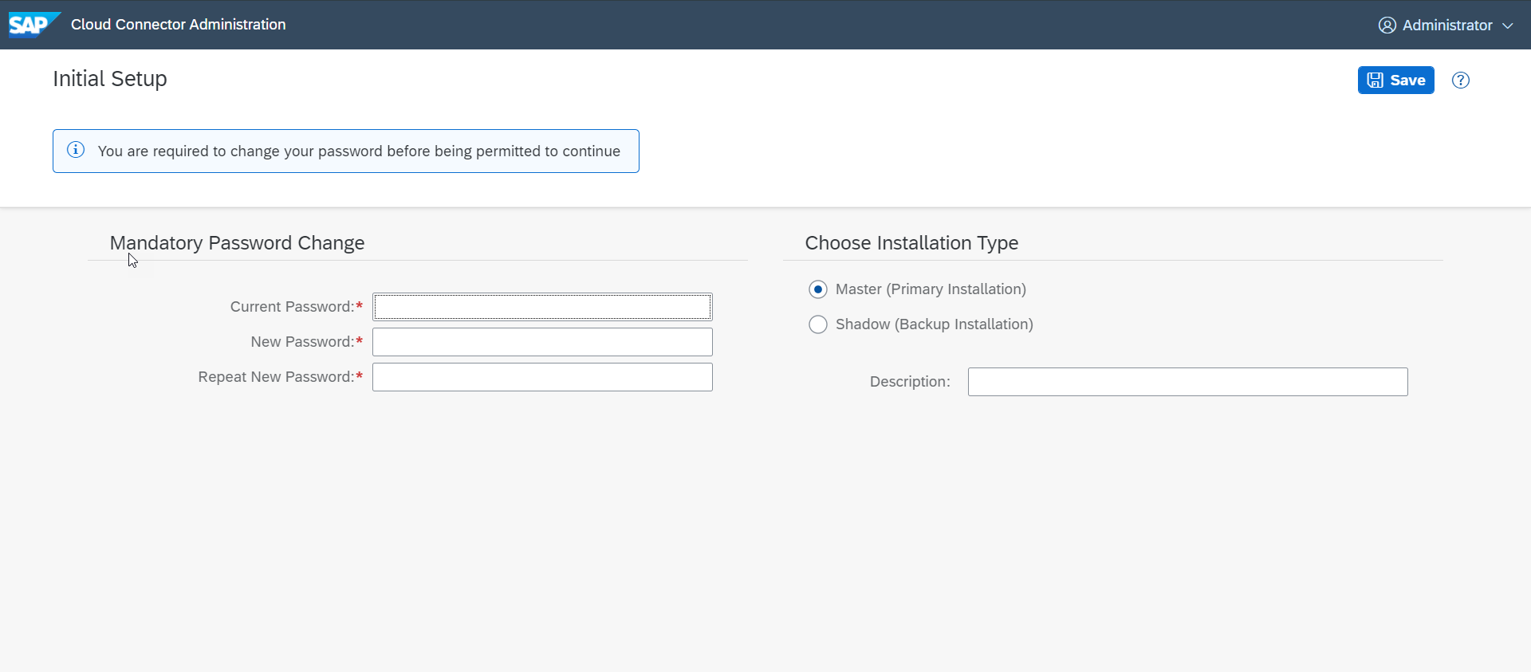
Cloud connector continue…
Step 3: Now your system is ready go to browser and open https://localhost:8443 (port may changes)
The default credentials are Administrator / manage

Slide 7
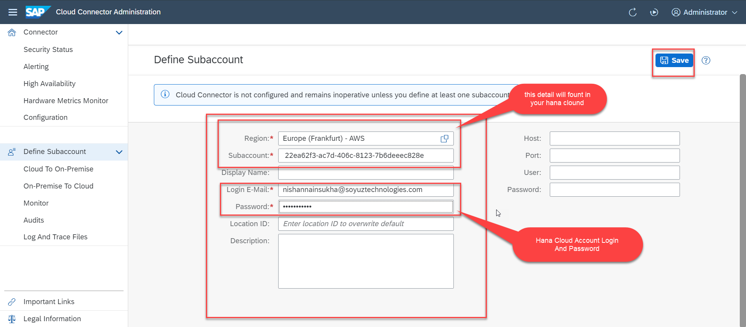
Cloud connector continue…
Step 4: Now we create a connection with our Cloud Account

Slide 8
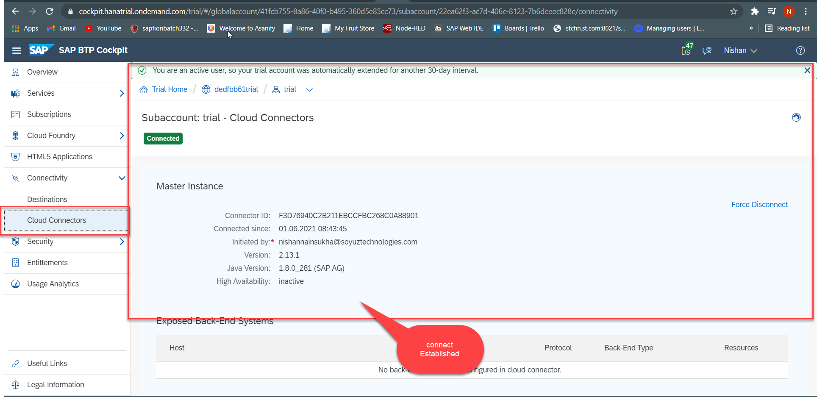
Cloud connector continue…
Step 5: Check the connection on Hana Cloud Account

Slide 9
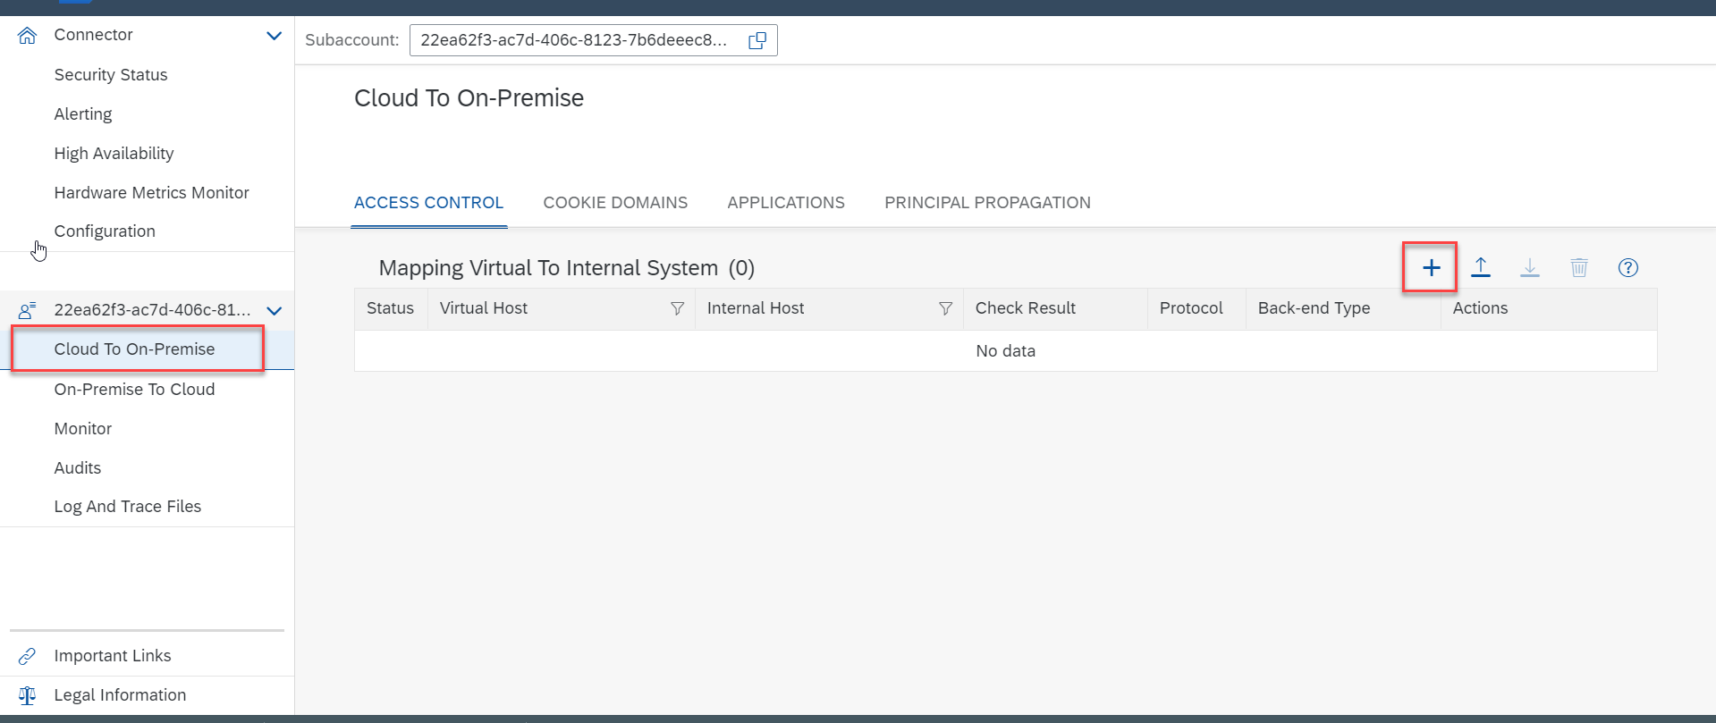
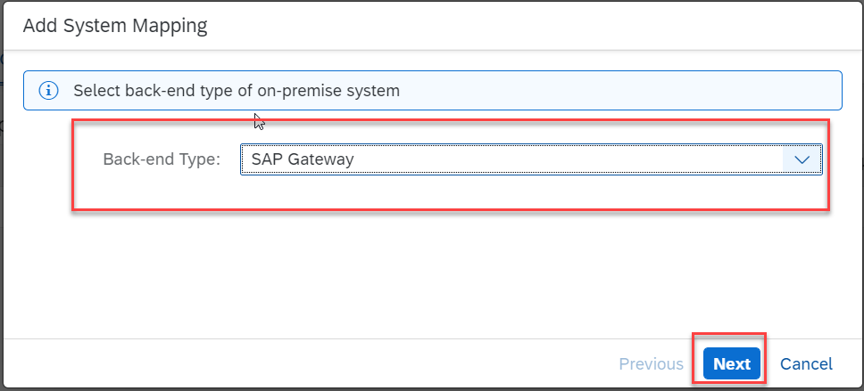
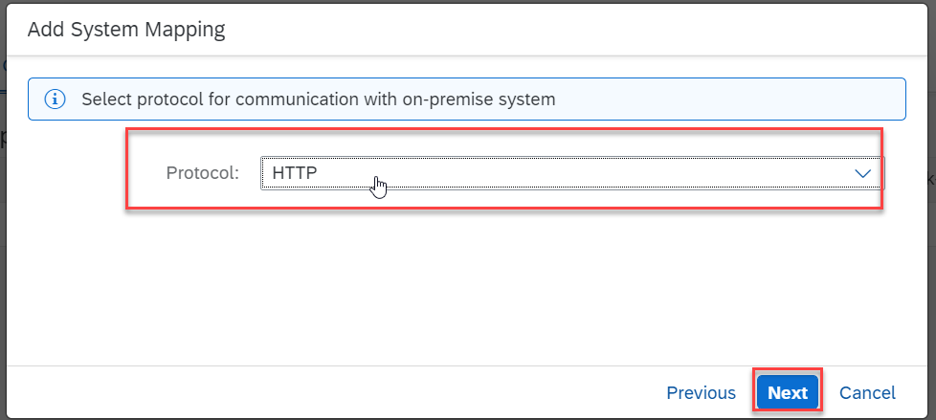
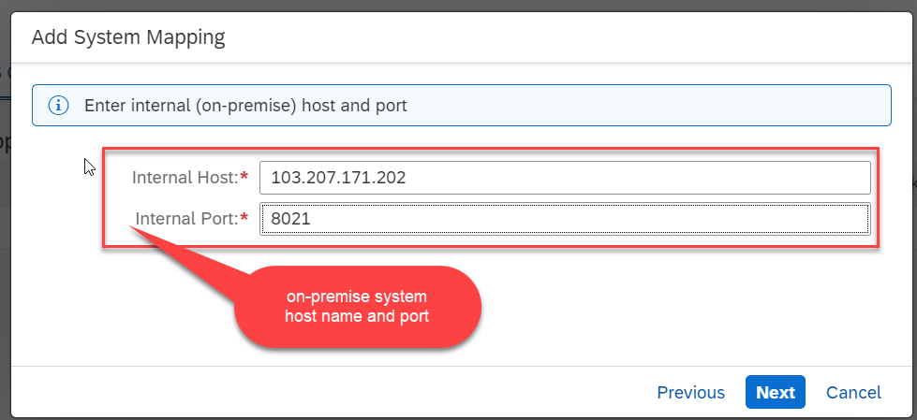
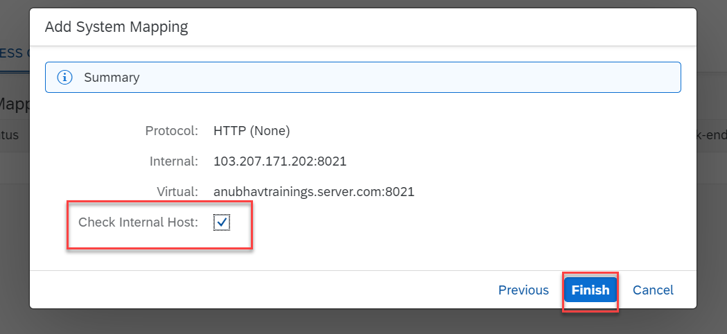
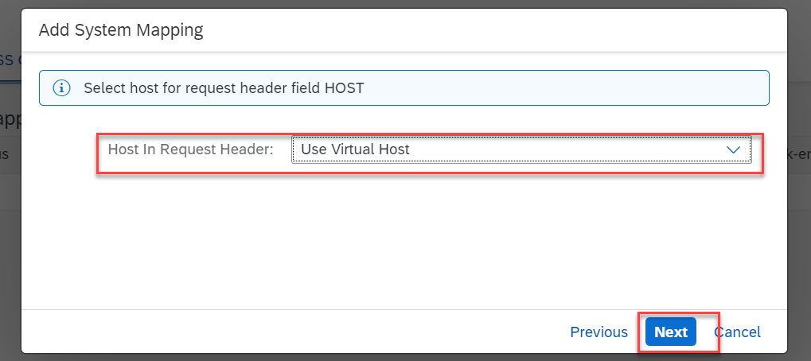
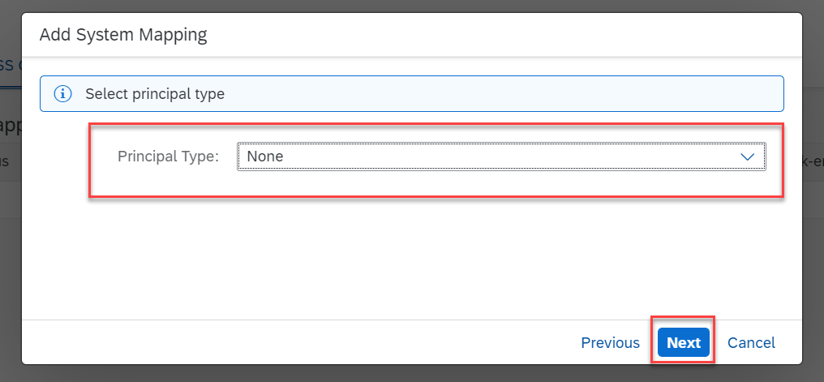
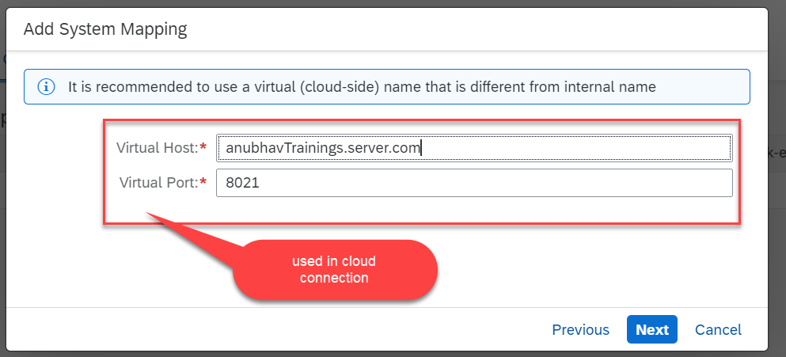
Cloud connector continue…
Step 6: Connect on-premise system to cloud using SCC

Slide 10
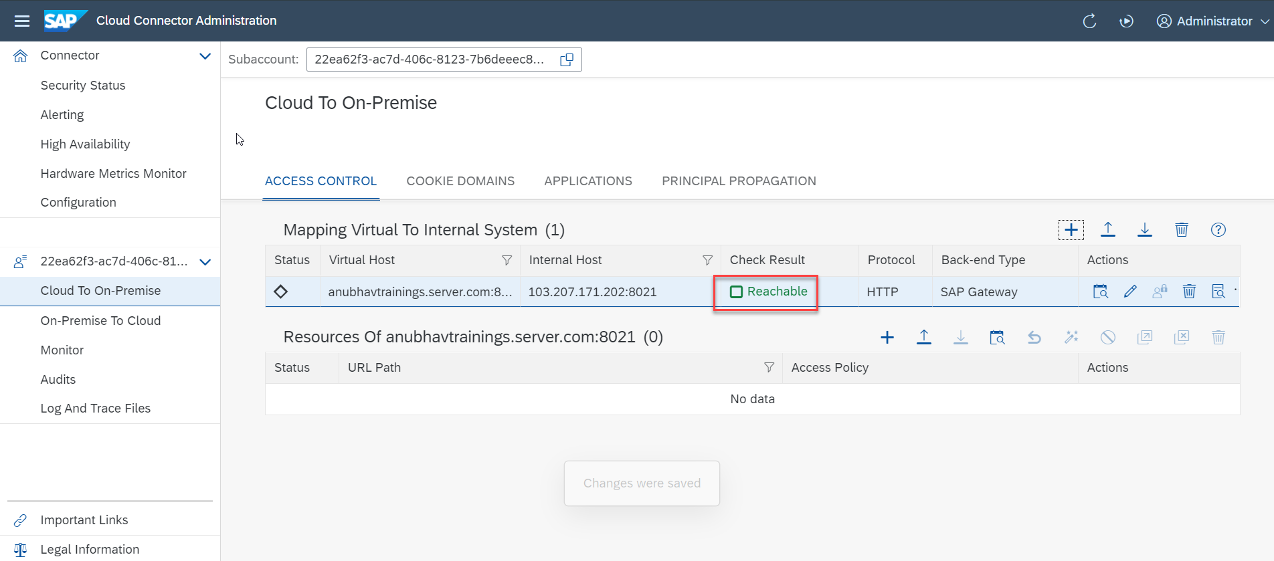
Cloud connector completed
We have Done with Connect , now we are now successfully connected to cloud using SCC.

Slide 11
CORS – Cross Origin Resource Sharing
It is a browser security policy which prevent us connecting to a domain while running web page on a different domain.
Browser
S
https://workspaces-ws-7qbs5-app3.eu10.trial.applicationstudio.cloud.sap/
Proxy
Facebook.com
Google.com
Another Server
http://103.207.171.202:8021/sap/opu/odata/sap/ZOCT_ODATA_SRV/$metadata
https://www.npmjs.com/package/@sap/ux-ui5-tooling

Slide 12

End of Day 12

Slide 13

Questions

Slide 14

Anubhav Oberoy

Slide 15


We’re committed to empower you to be
Most Desirable Resource
through powerful training solutions.
We build the workforce of the future.
250+
Corporate Clients
30,000+
Learners Trained
25000+
Learners Placed
FREE WEBINARS
Sign up for free webinars with industry experts every fortnight!
Enroll Now!
Contact us today!
https://anubhavtrainings.com/

Slide 16




More from AnubhavTrainings.com

Slide 17
Title
Content

